Slide 1
Final Project
Fabiolah Jones
Summer 2025
Data Science Programming

Slide 2
Are there factors that affect a student’s perception of their safety in school?
For this final project I used Jupyter Notebooks for python, Matplotlib to create visualizations, and pandas for data analysis. The dataset in this project is regarding Southern California students’ perception of their safety in school .
The dataset can be found at:
https://usc-geohealth-hub-uscssi.hub.arcgis.com/datasets/perceptions-of-school-safety/explore?location=34.117758%2C-117.162695%2C7.91&showTable=true.
The dataset was cleaned and 5 questions were asked of the data. Recommendations were made to the California Board of Education based on the results from this analysis.

Slide 3


Does gender play a role in 7th graders who feel very safe in school?

Slide 4
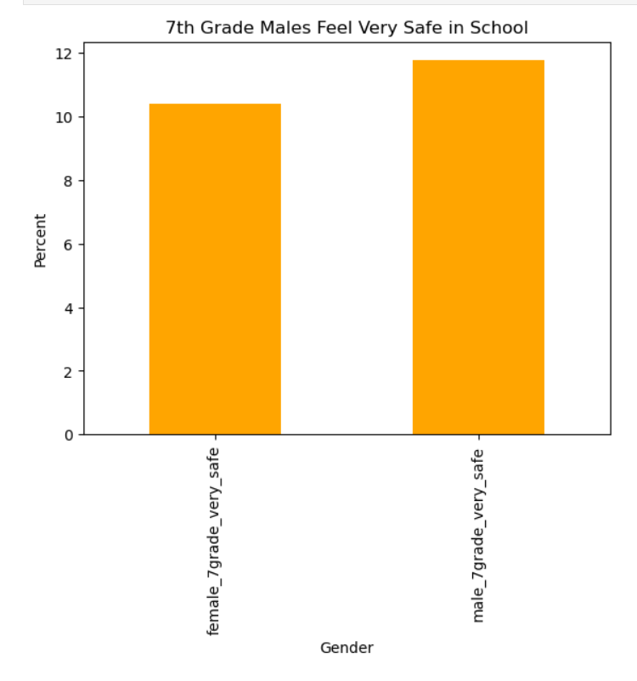
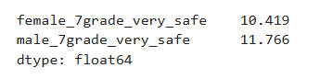
It is more likely for 7th grade males to feel safer than 7th grade females.

Slide 5

Does sexual orientation play a role in students feeling very unsafe in school?

Slide 6
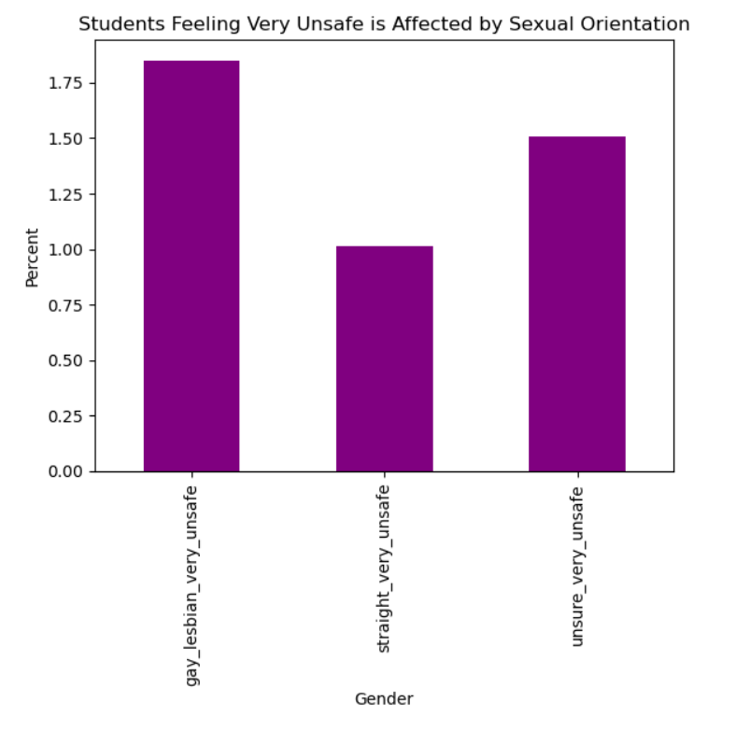
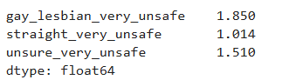
Students are more likely to feel very unsafe in school if they are gay or lesbian.

Slide 7

What is the breakdown of safety perception of students who have a low level of connectedness to school?

Slide 8
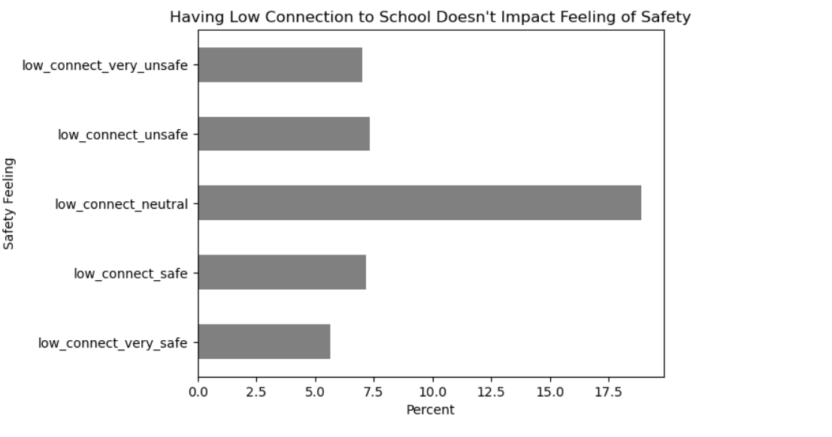
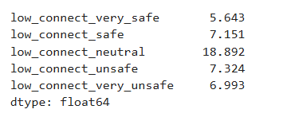
The majority of students who have a low connection to the school feel neither safe nor unsafe.

Slide 9
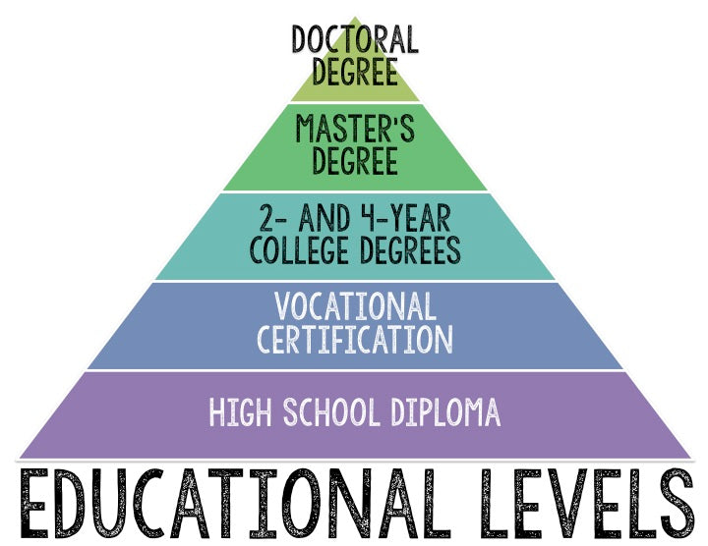
Does the parents’ level of education affect students who feel neither safe nor unsafe?

Slide 10
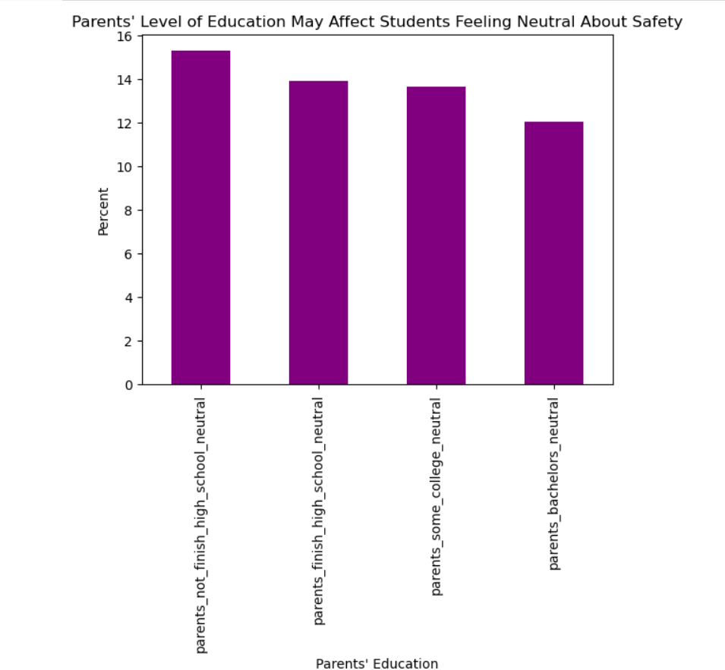
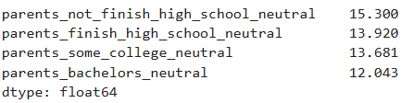
Students are more likely to have neutral feeling about their safety if their parents did not finish high school.

Slide 11

Does race play a role in students feeling safe?

Slide 12
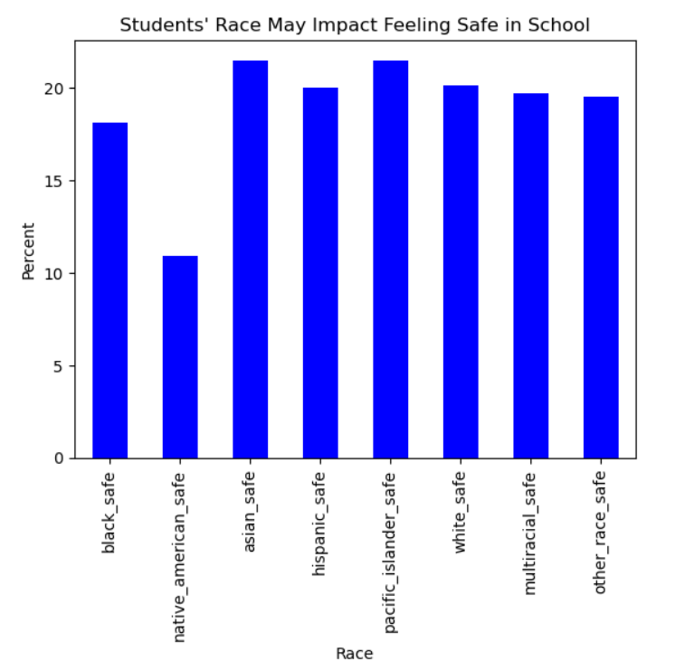
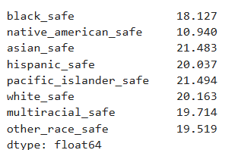
Native American students are less likely to feel safe in school compared to students of other races.

Slide 13


In conclusion
If I were presenting this to the California Board of Education, I would recommend some type of diversity and inclusion educational program. This program could highlight the different races of the student body and the students who are gay/lesbian.
To continue to analyze this data I would recommend a repeat survey. For example, this survey can be given in the beginning and end of the school year to see how the scores change. Possibly there are students who are new to the school and don’t have any friends or know what to expect, so repeating the survey at a later time with the same subjects could yield different results.

